Slide 1
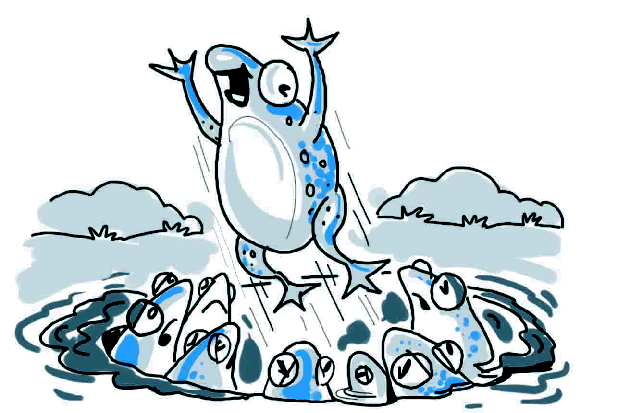
Fiz – The Frog

Slide 2
Positive
Thinking

Slide 3
Characteristics
Hope
Insult
Guilt
Anger
Concern
Strength
Dream
Confidence
Anxiety
Happiness
Weakness
Hate

Slide 4
Some Positive Characteristics
Hope
Creativity
Patience
Confidence
Cooperative
Happy
Flexible
Adventurous
Strong
Open minded
Empathetic
Compassionate

Slide 5


Slide 6
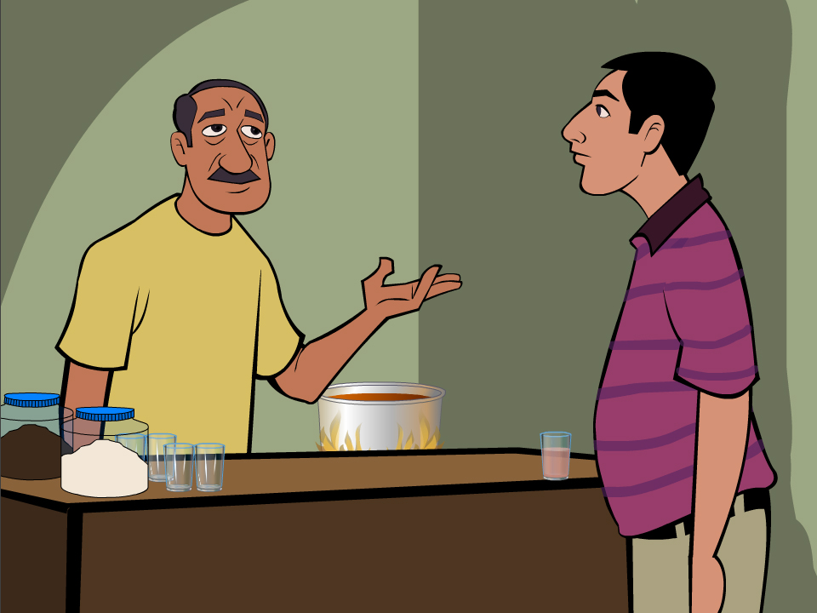

Slide 7

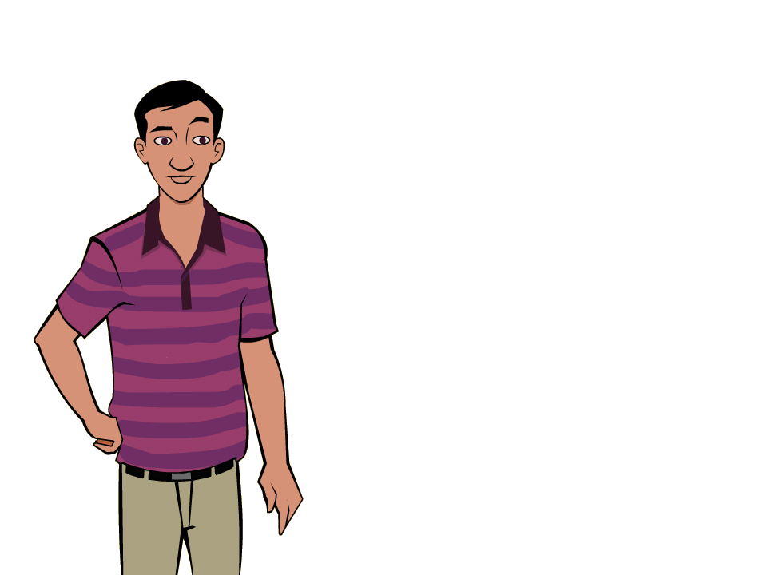



The Carrot - Tough from outside but
weak in adversity
The Egg - Soft inside but tough in adversity
The Coffee Bean - When things get worse it gets better

Slide 8
What about you?
The Carrot?
The Coffee Bean?
The Egg?

Slide 9
Attitude, Attitude!
So, what is attitude?
Your approach -
Your outlook towards situations and others

Slide 10
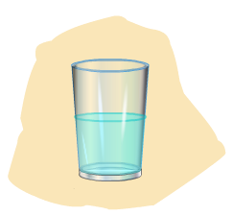

Slide 11

• Improving your behaviour from inside out
• Accepting responsibility for your actions
• Setting goals and living for a purpose
• Creating a mental picture of success
• Speaking positive
• Being helpful to others
• Being proactive

Slide 12

• Improved relationships
• Better behaviour at work
• More confidence
• Enhanced desire to contribute
• Further opportunities for success
• Improved efficiency

